Slide 1
SAP BTP Extension Suite Training
Day 10
Anubhav Oberoy
www.AnubhavTrainings.com
Follow excellence with sheer passion

Slide 2


DISCLAIMER
The training content and delivery of this presentation is confidential, and cannot be recorded, or copied and distributed to any third party, without the written consent of Anubhav Trainings

Slide 3
Agenda – Day 10
01
Implementing App Router
02
Git and Webhook
03
CI/CD Service in BTP

Slide 5
Challenges in Current Approach
Did you notice, that we need to first pass lots of technical details from service key
Pass all the info in correct manner to postman to obtain token
Once the token expired, we need to reobtain again and again
Our end user do not know all this. Automate the XSUAA JWT token processing.
In our app, we will have multiple microservices, like java, sap ui5, node app, xsuaa…
Each service produce one end point e.g. /vendors, /index.html, /customers, they all logically belongs to same app. Will you give 3 url to our user to access these apps?
These microservices also needs to communicate with each other. Provided we give a single end point to access our entire app to end user.
We want to complete redirect mechanism to let user go to login screen, authenticate on IDP and exchange of all the tokens should be seamless behind the scenes.
We need a single entry point for entire app, forwardAuth tokens should be done automatic.
url
Application router
(Provide single entry point, exchange auth token,
Communicate between microservices, like a facade)
xsuaa
Java
/Anubhav.svc
UI5 App
/index.html
Node
/customer

Slide 6
Introduction to App Router
It is a Node JS Application
It is used to automate the process of authentication, authorization with XSUAA to do token exchange
It sits in the middle of IDP and XSUAA, it will redirect the request to our microservice to xsuaa, and eventually to idp
IDP sends the login screen to the user, user authenticates, which is taken to XSUAA, XSUAA issues JWT Token, this JWT token is presented to api end points
App Router takes the JWT token from XSUAA and gives it to our microservices and even exchange this token to multiple microservices inside
It Serves as a single entry point for the entire app.
To tell app router about our multiple microservices so that it can re-direct, we need to create a configuration file named as xs-app.json which contains the details.

Slide 7



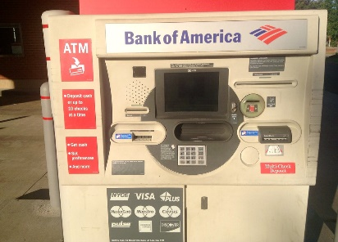
Real World Example
Customer
1
5
4
2
Loan
Credit Card
6
Validate, trust
Deposit
Draft/Cheque
3
FD
*******
7
Locker
This Photo by Unknown Author is licensed under CC BY

Slide 8
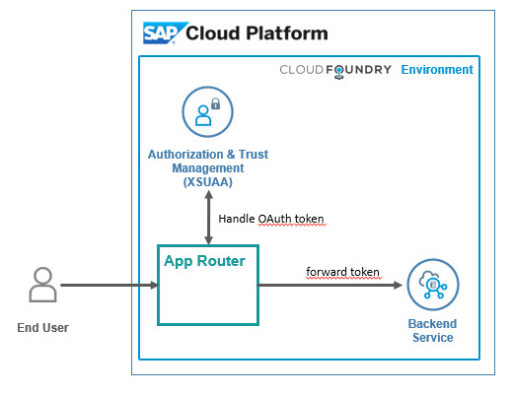
Hands on: App Router
Solution
https://github.com/soyuztechnologies/BTP_Architect_Training/blob/master/Day%203/04approuter.zip

Slide 9

What We Did
Let’s Summarize

Slide 10

www.anubhavtrainings.com
Thank You
End of Day 10

Slide 11


We’re committed to empower you to be
#FutureReady
through powerful training solutions.
We build the workforce of the future.
260+
Corporate Clients
60,000+
Learners Trained
26000+
Learners Placed
FREE WEBINARS
Sign up for free webinars with industry experts every fortnight!
Enroll Now!
Contact us today!
https://anubhavtrainings.com

